Slide 1
G5 - Smart Office Cleaner Robot

Slide 2
Objective
Main goal is to prepare robust, inexpensive affordable product with better efficiency

Slide 3
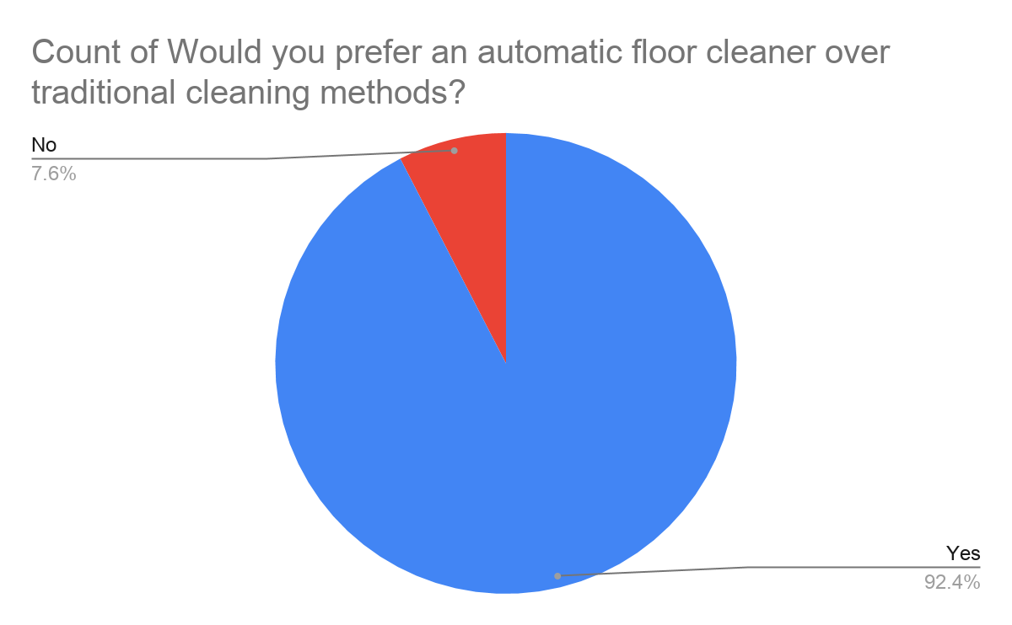
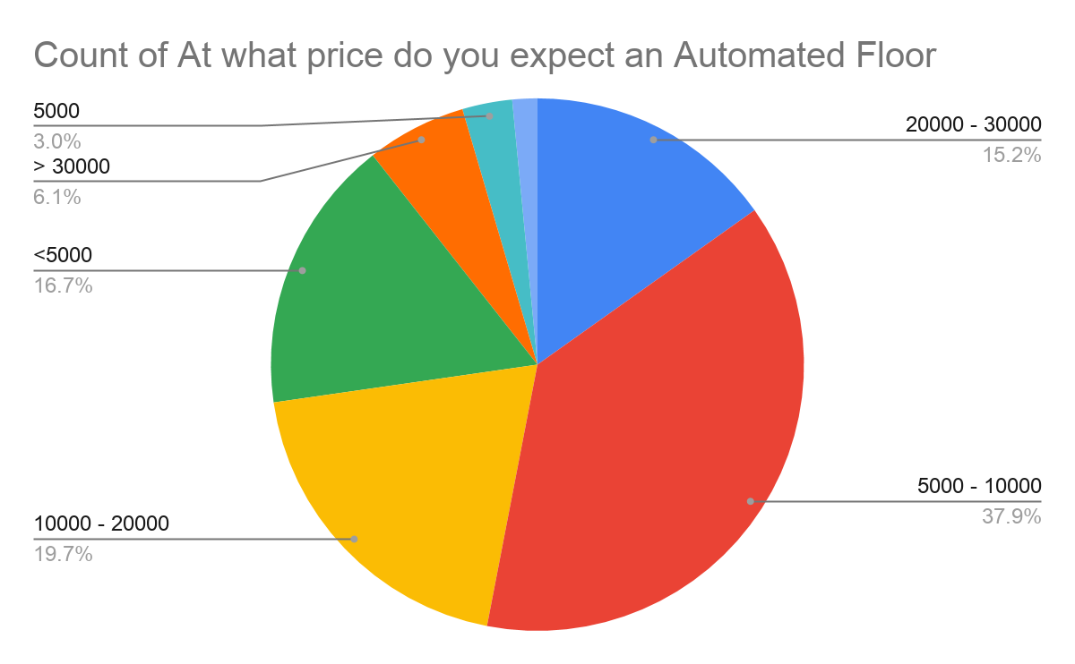
Market survey

Slide 4
Features to be added
Dry cleaning
Wet Mopping
UV Sanitisation
Obstacle Avoidance
Manual/Autonomous Control
Terrain Mapping
Smartphone Connectivity (WiFI)

Slide 5
Electronics to be used
Wifi Microcontroller
Motors with wheels(DC, Servo)
LIDAR sensor
PIR sensor
RTC Module
Battery
Sprayer and Blow dryer
UV Light

Slide 6
Parts to be fitted
Brushes
Mop roller
Dustbin
Water cylinder

Slide 7
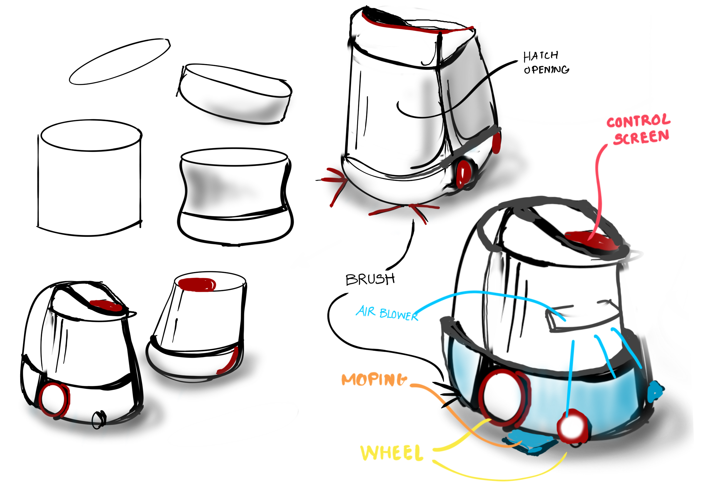
Proposed Design

Slide 8
Cycle diagram
04
Prototype
Refine
01
03
Display
Get feedback
02

Slide 9
Project timeline
Week 1
Week 2
Week 3
Week 4
Research & Planning
Robot Design Preparation
Circuit and Software Simulation
Final Concept Presentation and Research Paper Publication

Slide 10
Thank you!

